Slide 1


Telecom Data Analysis for TelCo
Gaurav Kumar

Slide 2
Introduction
Welcome to the Telecom Data Analysis presentation for TelCo. As we embark on this journey, we'll explore the intricate details of TelCo's telecom dataset to uncover valuable insights that will guide strategic decisions.
Background: Our journey is guided by a seasoned investor specializing in identifying undervalued assets. Building on past success stories, such as the transformative analysis of a delivery company, we aim to replicate the success with TelCo.
Objective: Today's objective is clear - to conduct a comprehensive analysis of TelCo's telecom dataset. Our focus will be on understanding user behavior, engagement, and overall experience, with the ultimate goal of providing strategic recommendations for future growth.

Slide 3
Agenda Overview
Let's preview the key tasks that will unfold in this presentation:
Task 1: User Overview Analysis
Task 2: User Engagement Analysis
Task 3: Experience Analysis
Task 4: Satisfaction Analysis

Slide 4
User Overview Analysis: Relevant variable and associated data types
To under the behaviors of the user, we have created a User_Behaviour_Dataset by aggregating following information:
Number of xDR (data sessions Detail Record) sessions
Session duration
The total download (DL) and upload (UL) data
The total data volume (in Bytes) during this session for each application
The User_Behaviour_Dataset ' comprises 21 columns, each exclusively containing numeric values.
The initial column is the 'Bearer ID,' serving as the user identifier.
Additionally, the dataset includes columns indicating session duration and data downloaded and uploaded through various applications.

Slide 5
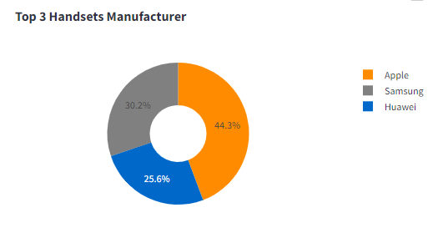
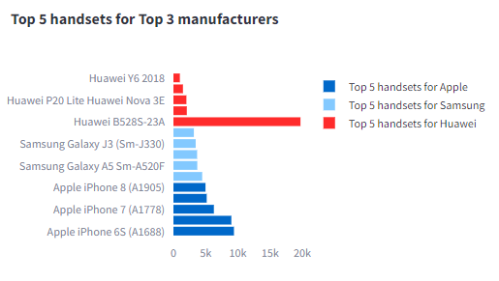
Leading Handset Manufactures
After conducting an analysis, it has been determined that the leading handset manufacturers are Apple, Samsung, and Huawei, with the respective top 5 handsets shown below.

Slide 6
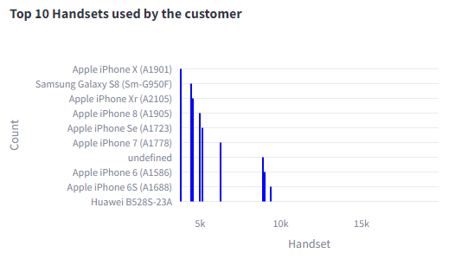
Top 10 Handsets used by the customers

Slide 7
Total Data (DL+UL) per Decile Class:
After segmenting the users into the decile classes based on the total duration for all sessions and compute the total data (DL+UL) per decile class, it has been determined that the below are top 5 decile user.
Decile MSISDN/Number
5 6405460219184
6 6125652316129
7 7806072300216
8 9286284987897
9 14831037946614

Slide 8
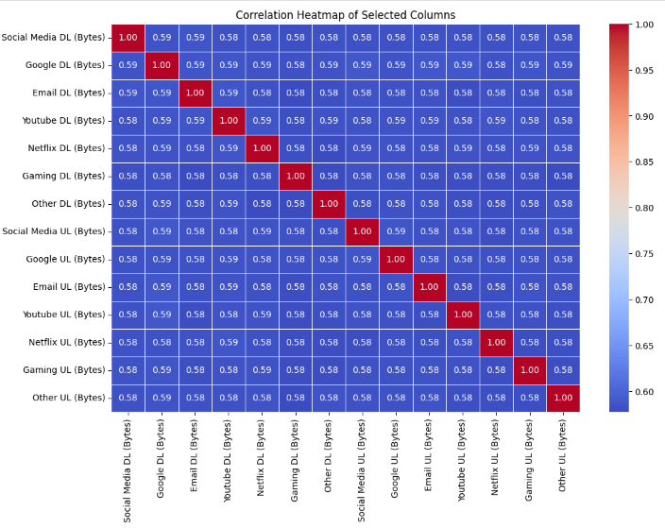
Correlation Analysis for each application

Slide 9
User Engagement Analysis
To under the engagement of the user on different applications, we have created another dataset named as User_Engagement_Dataset by aggregating following information:
Session's frequency
The duration of the session
The session total traffic (download and upload (bytes))

Slide 10
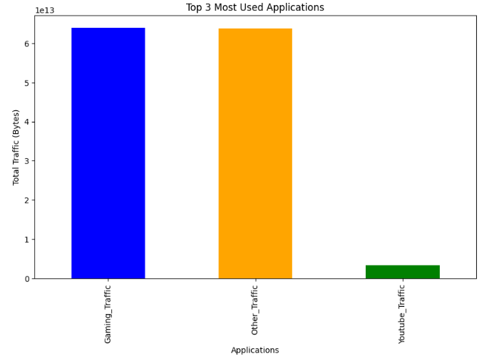
Top 3 most used applications
After conducting analysis on User_Engagement_Dtatset, it was determined that users are mostly using traffic for Gaming, Other and Youtube.

Slide 11
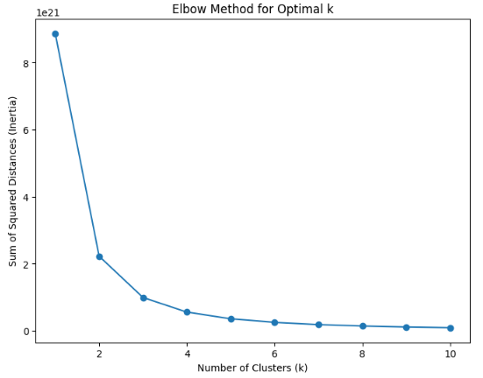
Elbow method to find Optimal K
The elbow point in the chart is at k=2, it suggests that having 2 clusters is an optimal choice for k-means clustering algorithm based on the engagement metrics.
The plot shows a clear elbow point, it suggests that there is a natural grouping in the data, and the optimal k is the value at the elbow.

Slide 12
Experience Analysis
In the telecommunication industry, the user experience is related, most of the time, to network parameter performances. To under the experience of the user, we have created another dataset named as User_Experience_Dataset by aggregating following information as :
Average TCP retransmission
Average RTT
Handset type
Average throughput

Slide 13
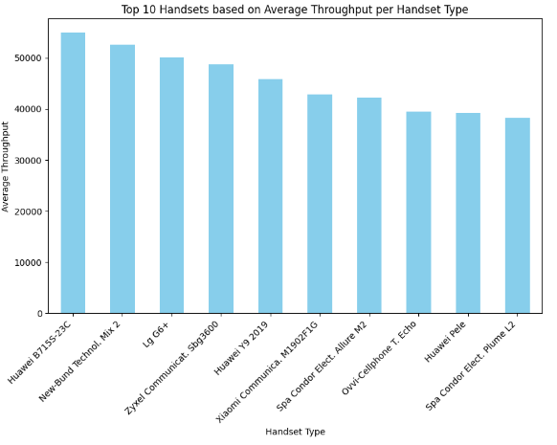
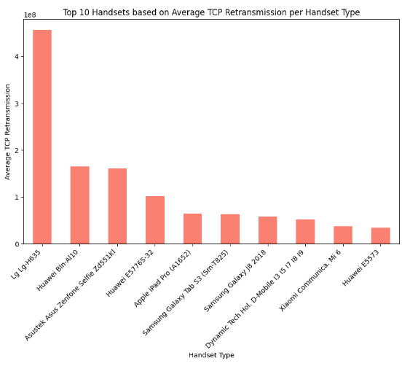
Distribution of Average Throughput and average TCP retransmission Handset Type:
After analyzing the bar charts depicting the top handsets based on average throughput and TCP retransmission, it was observed that there is no discernible pattern indicating a specific type of handset utilizing significantly more or less network traffic. The distribution of traffic appears to be diverse across various handset types.

Slide 14
Satisfaction Analytics
Satisfaction of a user is dependent on user engagement and experience. Based on engagement analysis + the experience analysis, we assigned score to each user using Euclidean Distance.
We considered the engagement score as the Euclidean distance between the user data point & the less engaged cluster.
We consider the experience score as the Euclidean distance between the user data point & the worst experience cluster.

Slide 15
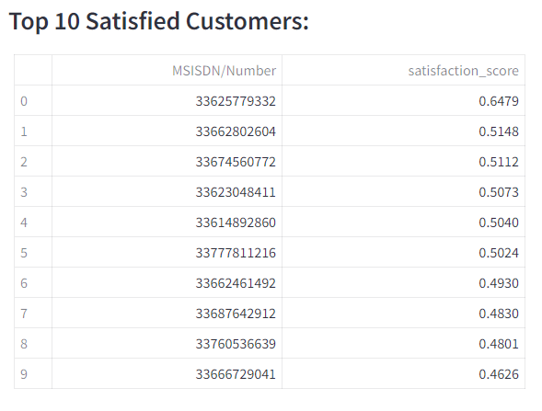
Conclusion: In conclusion, our analysis reveals a significant volume of network traffic with a diverse range of user behaviors. Despite the high usage, our investigation into user engagement and experience data, coupled with the assignment of corresponding scores, highlights a nuanced landscape. After amalgamating engagement and experience metrics and deriving satisfaction scores, it becomes apparent that the highest satisfaction score achieved is 0.6479. However, the overall average satisfaction score falls below the midpoint at less than 0.5. This suggests a scope for improvement in enhancing user satisfaction, warranting further exploration and strategic considerations to elevate the overall user experience.

Slide 16
Thank you!

